Slide 1

YOUR BUSINESS
SUCCESS
STARTS WITH SEO

Slide 2

Fall Semester
SMU
Data Science Bootcamp

Slide 3

Covid
Cases
Can your
Culture
Harm you?
SMU Data Science Project 2

Slide 5



About Us
Philosophy / Mission / Who We Are
^{Philosophy}
^{Who We Are}
We believe in first page rankings. We believe in colossal traffic. We believe in generating phenomenal leads. We believe in significant ROI. We believe in going big online.
We are an experienced search marketing firm sworn to making websites more visible and profitable. We tackle sites head-on, researching and implementing the sharpest tools and techniques in the industry to put our clients ahead of their online competition. Powered by our team of search engine optimization experts, companies experience refreshing hikes in organic website traffic, brand awareness, and ultimately – conversions and revenue.
^{Mission}
To advance the visibility and profitability of our clients’ business and brands.
^{Seotwitter.com}
^{Pinterest.user}
^{www.cosapient.com}

Slide 6





Our Services
^{Search Engine Optimization}
Search Engine Optimization / SEO Analysis / SEO Training
SEO is an acronym for “search engine optimization” or “search engine optimizer.” Deciding to hire an SEO is a big decision that can
^{SEO Analysis}
Our professional search engine optimization team will take an in-depth look at the competitive marketplace for your chosen keywords and help you develop the.
^{SEO Training}
SEO GOAL has helped our company increase site traffic and significantly improve keyword rankings. We’ve enjoyed working with their team and have loved the positive results
^{Seotwitter.com}
^{Pinterest.user}
^{www.seogoal.com}

Slide 7










Our Services
^{Major Services on this Company}
^{Search Engine Optimization}
^{Target Keyword}
^{Social Engagement}
SEO is an acronym for “search engine optimization” or “search engine optimizer.” Deciding to hire an SEO is a big decision that can
SEO is an acronym for “search engine optimization” or “search engine optimizer.” Deciding to hire an SEO is a big decision that can
SEO is an acronym for “search engine optimization” or “search engine optimizer.” Deciding to hire an SEO is a big decision that can
^{Web Development}
^{Affliate Marketing}
^{Creative Campaings}
SEO is an acronym for “search engine optimization” or “search engine optimizer.” Deciding to hire an SEO is a big decision that can
SEO is an acronym for “search engine optimization” or “search engine optimizer.” Deciding to hire an SEO is a big decision that can
SEO is an acronym for “search engine optimization” or “search engine optimizer.” Deciding to hire an SEO is a big decision that can
^{Branding Services}
^{Website Optimization}
^{Support Services}
SEO is an acronym for “search engine optimization” or “search engine optimizer.” Deciding to hire an SEO is a big decision that can
SEO is an acronym for “search engine optimization” or “search engine optimizer.” Deciding to hire an SEO is a big decision that can
SEO is an acronym for “search engine optimization” or “search engine optimizer.” Deciding to hire an SEO is a big decision that can
^{Seotwitter.com}
^{Pinterest.user}
^{www.seogoal.com}

Slide 8












Our Services
^{All Services}
^{Keyword Research}
^{Competitive Analysis}
^{Link Building}
Optimization Services and Content Development
^{Press Release Optimization}
Local Search Optimization Mobile SEO
^{International Search}
^{Shopping Search}
^{Video SEO}
^{Web Marketing Analytics}
^{Reporting/KPIs}
^{Seotwitter.com}
^{Pinterest.user}
^{www.seogoal.com}

Slide 9


Our Services
^{I}
Details Services / Keyword Research
^{Keyword Research}
Our search engine marketing services start with identifying the keywords your target audience uses when searching for your products or services. It is a crucial step of the optimization process. You have to reach the right audience to generate a high return on investment. We can help you choose the best keywords based on search frequency and relevance to your website. Carefully targeting your campaign from the start will lead to greater success down the road.
“After reviewing our site and establishing our goal, SEO Goal employed the most impactful ‘best practices’ in SEO programming, design and coding. The results speak for themselves. SEO Goal has become a strategic partner not only regarding web based marketing but as a contributor to our comprehensive marketing program.”
^{Seotwitter.com}
^{Pinterest.user}
^{www.seogoal.com}

Slide 10
Our Services
^{II}
Details Services / Competitive Analysis
^{Competitive Analysis}
The Internet is an extremely competitive marketplace. There are other companies targeting your keywords and reaching your potential customers. Analyzing your competition’s online strengths and weaknesses can reveal opportunities for you. Our professional search engine optimization team will take an in-depth look at the competitive marketplace for your chosen keywords and help you develop the strategies to reach the top and stay there.
^{Seotwitter.com}
^{Pinterest.user}
^{www.seogoal.com}

Slide 11

Our Services
^{III}
Details Services / Link Building
Building relevant links from other websites is an intricate process. We employ a wide range of methods and techniques to attract valuable links, and the right links, to build your rankings. We work to build a well-rounded link portfolio that includes many kinds of links and opportunities to help you compete. Relevant, high-quality links are one of the most important factors in determining how well a website will rank in the search engines. Building relevant links from other websites is an intricate process that requires time and patience.
^{Link}
^{Building}
^{Seotwitter.com}
^{Pinterest.user}
^{www.seogoal.com}

Slide 12



Our Services
^{IV}
Details Services / Website Optimization Service & Conrent Development
A winning content strategy is extremely important to online success. Search engines index new and unique content, which means there is a lot of SEO value to optimize your Web copy. However, the final product needs to be more than just content for search engines. Good copywriting will not only help to increase your rankings, but aids in converting your visitors to paying customers. Our writers produce professional, unique content that delivers a clear and optimized marketing message to both search engines and users.
Website Optimization Service & Content Development
^{Seotwitter.com}
^{Pinterest.user}
^{www.seogoal.com}

Slide 13

Our Services
^{V}
Details Services / Online Public Relation, Press Release Optimization
Online Public Relation / Press Release Optimization
Newsworthy items can spread extremely fast over the Internet, and you can easily target the audience that is interested in your message. Online PR is an efficient and less expensive route than traditional public relations. Online press releases also add SEO and website optimization benefits by sending traffic and links back to your site. We can help you announce new developments in your company and make the most of the SEO and PR benefits.
^{Seotwitter.com}
^{Pinterest.user}
^{www.seogoal.com}

Slide 14

Our Services
^{VI}
Details Services / Local Search Optimization
With the development and recent improvements of smart phones, mobile search engine usage is increasing in popularity. Optimizing for mobile SEO solicits a unique strategy that facilitates quick and easy viewing of the most important information about your business.
^{Local Search Optimization}
^{Seotwitter.com}
^{Pinterest.user}
^{www.seogoal.com}

Slide 15

Our Services
^{VII}
^{Details Services / Mobile SEO}
^{Mobile SEO}
With the development and recent improvements of smart phones, mobile search engine usage is increasing in popularity. Optimizing for mobile SEO solicits a unique strategy that facilitates quick and easy viewing of the most important information about your business.
Although traffic from mobile devices will surpass traffic from desktop devices in the very near future, there is still ample time to take inventory of your web presence discoverability across devices and set the SEO and content marketing wheels in motion to ensure maximum reach and engagement.
^{Seotwitter.com}
^{Pinterest.user}
^{www.seogoal.com}

Slide 16

Our Services
^{VIII}
Details Services / International Search
How to Start a Realistic
International SEO Campaign
^{International Search}
Global search marketing targets international and multilingual markets so that companies can reach out beyond their national borders to a worldwide audience. At SEO GOAL, we can help you employ the right strategies to effectively market yourself and build international search engine rankings.
^{Seotwitter.com}
^{Pinterest.user}
^{www.seogoal.com}

Slide 17

Our Services
^{IX}
Details Services / Shopping Search & E-Commerce Solution
^{Shopping Search /}
^{E-Commerce Solution}
^{SEO-Cart is} a class leading ecommerce solution for businesses of all sizes.
We will help you target users who go online to compare products from different vendors, or search for an online store or product by category. By ranking well in these searches, your customers can find and buy your products with just a couple of clicks.
^{Seotwitter.com}
^{Pinterest.user}
^{www.seogoal.com}

Slide 18

Our Services
^{X}
Details Services / Video SEO & Video Marketing
^{Video SEO /}
^{Video Marketing}
Improving your chances of earning high-ranking video spots within Google’s blended search results.
Reaching out to busy customers who prefer to consume content in video format, rather than in text-based articles.
Showcasing product or service features that aren’t adequately captured in text- or image-based content.
Forming a Youtube channel that attracts a following and earns income through ad revenue.
Creating “viral style” videos that increase your chances of building a massive online following.
Modern search engine optimization can include a range of multimedia strategies to build rankings and drive traffic to your site. Search engines provide video results on related keywords. We will help you develop a multimedia campaign that complements your SEO efforts and allows you to reach a broader audience by optimizing videos for search.
^{Seotwitter.com}
^{Pinterest.user}
^{www.seogoal.com}

Slide 19

Our Services
^{XI}
Details Services / Web Marketing Analysis
^{Web Marketing Analysis}
Internet Marketing Company, Avital Web, Offers Free SEO Analysis
Search marketing campaigns should be by closely and regularly analyzed. SEO GOAL will set up analytics reporting on your site and then offer professional consultation and recommendations on how to take advantage of the data. We examine all the relevant metrics and data related to your site visitors to determine what keywords and search engines are driving the most traffic, and what changes need to be made to your site to increase relevant traffic and conversions.
“
^{Break Down}
Your Competitors SEO Strategy & Tactics
”
^{Seotwitter.com}
^{Pinterest.user}
^{www.seogoal.com}

Slide 20

Our Services
^{XII}
Details Services / Web Marketing Analysis
“
^{Reporting / KPIs}
SEO is one of the most important techniques of online marketing. It helps the site to attract organic visitors from search engine
“
At SEO Goal, we believe in being completely accountable to our clients. We provide a detailed account of your website’s key performance indicators so you can easily see the improvements made from our efforts.
Identifying the right KPIs for your Call Centre is important, which is why we've put together the most effective KPIs for managing, monitoring and analysing this fast paced environment
^{Seotwitter.com}
^{Pinterest.user}
^{www.seogoal.com}

Slide 21
What is SEO?
Google displays sites it believes are authoritative and relevant. They measure relevance by analysing page content, the words you and I read, and they measure authority (mostly) based on the number and quality of other pages linking to the pages they show, links are like votes.
Search engine optimization is a method of getting your website to rank higher in search engines—such as Google, Yahoo or Bing. A search engine optimization campaign pairs on-site optimization with off-site tactics, which means you make changes to your site itself while building a portfolio of natural looking back links to increase your organic rankings. When Internet users search for your products or services, your website needs to be the first one they find. SEO helps the search engines recognize your relevance to specific keywords that people search for online. The search engine optimization process includes researching keywords, creating content, building links and making sure your website is visible in the search engines.
^{Seotwitter.com}
^{Pinterest.user}
^{www.seogoal.com}

Slide 22
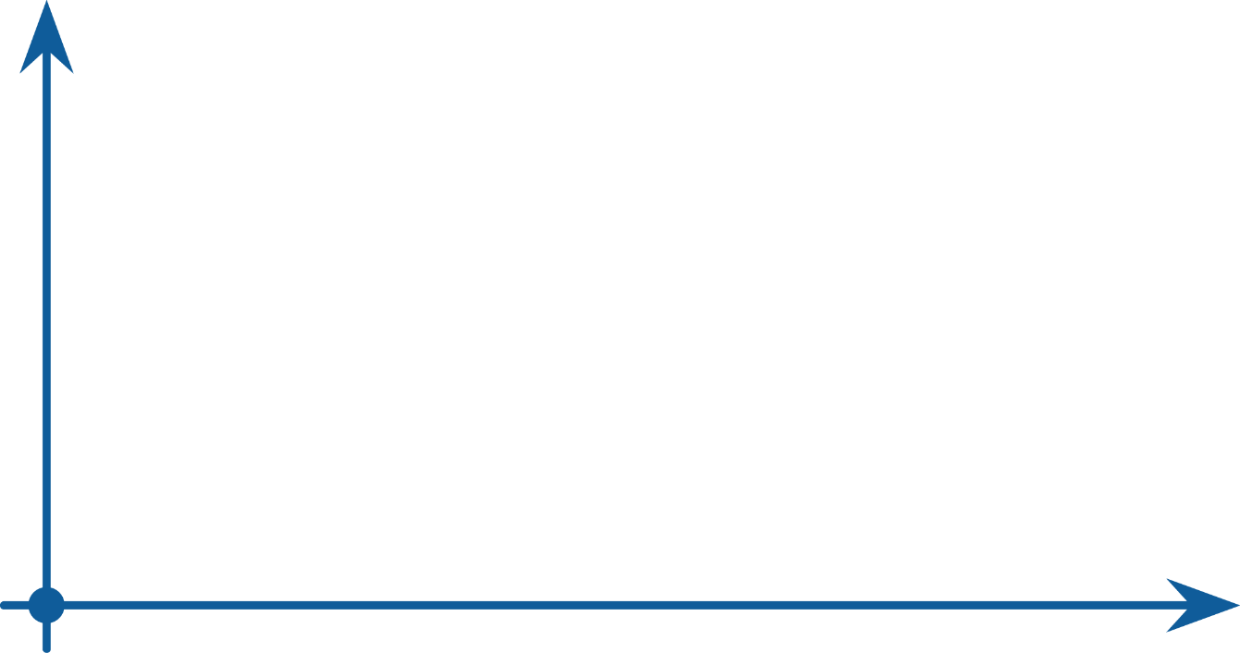






SEO Infographic
^{I}
SEO Faqs & Guide For Business Growth
^{Keyword Reserach}
^{LONGTAIL SEO FOR B2BS}
^{1 Word Phrase “SEO”}
^{2-3 Word Phrase “SEO Agency”}
“
“
This is s presentation on Longtail Keyword Research and Analysis using various tools starting from finding your keywords, searching for various parameters for your keywords, analyzing the parameters.
^{Higher Converting Phrases}
^{“Search Engine Optimization}
^{Agency SEO BOAL”}
^{COMPETITION}
^{HIGH SEARCH FREQUENCY}
^{LOW SEARCH FREQUENCY}
^{Seotwitter.com}
^{Pinterest.user}
^{www.seogoal.com}

Slide 23





SEO Infographic
^{II}
SEO Faqs & Guide For Business Growth
^{Site Architecture & Structure}
^{CINSIDER THE} ^{SITE HIERACHY}
^{USE BREADCUMB LINKS}
Some websites use a strict hierarchy of pages for their information design. On these sites, there will be an index page that links to subpages. Each subpage (parent page) has its own subpages (child pages). In this pattern, child pages are only linked from its parent page
EACH CATEGORY AND PRODUCT SHOULD HAVE ITS OWN PAGE.
^{Seotwitter.com}
^{Pinterest.user}
^{www.seogoal.com}

Slide 24

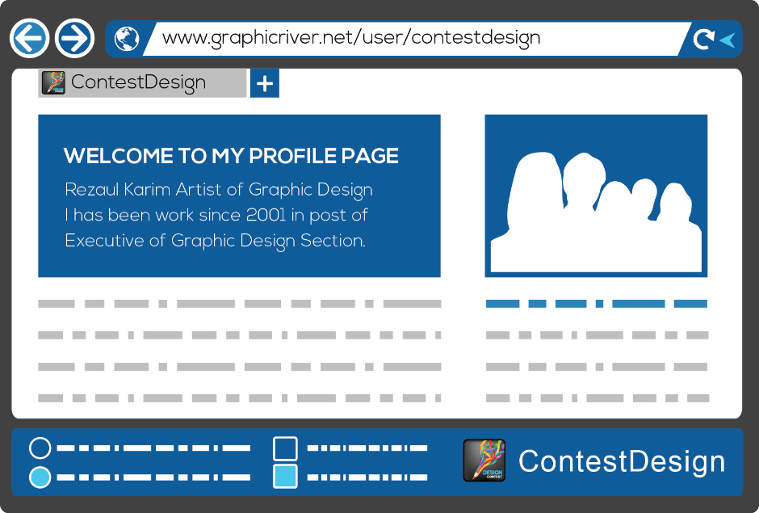



SEO Infographic
^{III}
SEO Faqs & Guide For Business Growth
^{Page Search Optimization}
^{META TAG DESCRIPTION}
^{KEYWORDS USE IN}
^{URL}
THERE ARE A VARIETY OF PAGE ELEMENTS THAT LET USERS AND SEARCH ENGINES
KNOW WHAT YOUR WEBSITE PAGES ARE ABOUT
^{PAGE TITLE}
^{IMAGE ALT}
^{ATTRIBUTES}
^{PAGE HEADING H1-H2}
^{INTERNAL LINKS}
^{BODY}
^{CONTENT}
^{Seotwitter.com}
^{Pinterest.user}
^{www.seogoal.com}

Slide 25





















SEO Infographic
^{IV}
SEO Faqs & Guide For Business Growth
^{Content Marketing}
^{& Linking}
^{LINKBAIT}
^{BLOG GUEST POSTING}
^{DIRECTORY}
Digital marketing is important to your mix and getting a finely tuned strategy in place will increase and maximize the effectiveness of this channel.
^{INTERNAL LINK}
^{COMPETITOR ANALYSIS}
HEAVING GREAT CONTENT ON YOUR SITE SHOWS USERS AND SEARCH ENGINES THAT YOU ARE AN AUTHORITY IN YOUR INDUSTRY.
^{DIGITAL PR}
^{PROFILE PAGES}
^{TRADE ASSOCIAITIONS}
^{BLOGGER REVIEWS}
^{PRESS RELEASES}
^{Seotwitter.com}
^{Pinterest.user}
^{www.seogoal.com}

Slide 26





SEO Infographic
^{V}
SEO Faqs & Guide For Business Growth
^{SEO Trastics}
^{XML SITEMAP CREATION}
^{VERTICAL SEARCH TARGETING}
^{INTERNAL LINK ARCHITECTURE}
^{REWRITING DYNAMIC URLS}
^{PAGE RANK SCULPTING}
^{KEYWORD RESEARCH}
^{ON-PAGE OPTIMIZATION}
^{EMBEDDED WIDGETS AND BADGES}
^{VIRAL CONTENT LINKBAIT}
^{SPAM REPORTING COMPETITORS}
^{DMOZ/YAHOO DIRECTORY SUB.}
^{WIKIPEDIA LINKS}
^{PRESS RELEASE OPTIMIZATION}
^{META KEYWORDS}
^{SEARCH ENGING SUBMISSION}
Spam links often go both ways. A website that links to spam is likely spam itself, and in turn often has many spam sites linking back to it. By looking at the totality of these links in aggregate, search engines can understand the "link neighborhood" your website exists in. Thus, it's wise to choose those sites you link to carefully and be equally selective with the sites you attempt to earn links from
The more popular and important a site is, the more links from that site matter. A site like Wikipedia has literally 1000's of diverse sites linking to it, which means it's probably a popular and important site. To earn trust and authority with the engines, you'll need the help of other link partners. The more popular, the better.
^{White Hat}
^{Low Value}
^{SEO}
^{TRACTICS}
^{High Value}
^{DO FOLLOW BLOG COMMENTS}
^{PAID DIRECTORY LINK BUILDING}
^{IP CLOAKING}
^{INJECTED LINKS}
^{PARASITE HOSTING}
^{RECIPROCAL LINK TRADING}
^{AUTOMATED CONTENT GENERA.}
^{KEYWORD STUFFING}
^{Black Hat}
^{Seotwitter.com}
^{Pinterest.user}
^{www.seogoal.com}

Slide 27












SEO Infographic
^{VI}
SEO Faqs & Guide For Business Growth
^{Linkbaiting & Social Media}
^{CONTENT CREATED}
^{MAJOR BLOG}
^{SEES CONTENT ON}
^{DIGG’S FRONT PAGE,}
^{LINK TO POST ABOUT IT}
^{CONTENT}
^{HITS}
^{DIGG’S FRONT PAGE}
^{TWEET ABOUT}
^{ON TWITTER}
^{TWITTER USERS POST}
^{ON FACEBOOK}
THE SOCIAL MEDIA EFFECT (SOCIAL NETWORKING)
Linkbaiting is sometimes perceived in a negative light, perhaps because some linkbaiting techniques intentionally polarise opinion. But mainly linkbait is simply a case of creating great content. Hardly controversial.
^{4,000,000}
^{UNIQUE VISITORS}
^{SMALLER BLOGS}
SEE CONTENT ON LARGE BLOGS AND POST ABO IT
^{500,000,000 UNIQUE VISITORS}
DIGG USERS SUBMIT STORY TO REDDIT, MAKES FRON PAGE
^{250,000,000 UNIQUE VISITORS}
SEVERAL FOLLOWERS RETWEET TO THEIR FOLLOWERS
^{150,000,000 UNIQUE VISITORS}
^{DIGG USERS SUBMIT}
^{STORY TO REDDIT,}
^{MAKES FRONT PAGE}
^{CONTENT GETS}
^{RETWEETED}
^{ALL OVER TWITTER}
^{CONTENT}
^{SHARED FRIENDS}
^{TO FRIENDS}
^{Seotwitter.com}
^{Pinterest.user}
^{www.seogoal.com}

Slide 28




SEO Infographic
^{VII}
SEO Faqs & Guide For Business Growth
^{SEO vs PPC}
^{SEO vs PPC Clicks}
It's been said before, but it bears repeating: Traffic is the lifeblood of any online undertaking. The success of an online business greatly depends on the amount of traffic it can generate for its pages. This is an indubitable fact
What is subject to a lot of debate, however, is the matter of SEO vs. PPC, two of the most powerful traffic generating approaches. SEO stands for search engine optimization. PPC stands for pay per click. Though their end goal is the same, they are different concepts that require different techniques and methodologies.
^{SEO CLICKS}
^{42% OF ALL SEARCHERS}
^{CLICK ON THE TOP RANKED}
^{RESULT}
^{PPC CLICKS}
^{WHEN SEARCHING}
^{ONLY 23% CLICK A}
^{PPC LINK}
^{Seotwitter.com}
^{Pinterest.user}
^{www.seogoal.com}

Slide 29

SEO Infographic
^{VIII}
SEO Faqs & Guide For Business Growth
^{SEO vs PPC}
^{15%}
^{TRY A DIFFERENT}
^{SEARCH OR SEARCH}
^{ENGINE}
^{SEARCH USER BEHAVIOR}
“
Search Engine Optimization (SEO) is the craft of elevating websites or individual website pages to higher rankings on search engines through programming, marketing, or content acumen. This article covers the origins of SEO, strategies and tactics, history and trends, and the evolution of user behavior in online searching
^{62%}
^{CLICK A PAGE}
^{ONE RESULT}
“
^{23%}
^{CLICK A RESULT}
^{ON SECOND PAGE}
^{OR AFTER}
^{Seotwitter.com}
^{Pinterest.user}
^{www.seogoal.com}

Slide 30

SEO Infographic
“
^{IX}
SEO Faqs & Guide For Business Growth
^{ROI SEO vs PPC}
“
In SEO if you rank well for one page , you have chance to get some ranking advantages for other relevant pages as well
One of the best reasons to use SEO to develop your online visibility is because it builds long-term value for your website. Even though constant SEO development is recommended for best results, if you need to take a break from SEO for a couple of months you won’t lose all your traffic. This makes the potential ROI of SEO great, but hard to measur
^{SEO CAMPAINGS}
^{PPC}
^{CAMPAINGS}
^{0%}
^{5%}
^{10%}
^{15%}
^{20%}
^{25%}
^{30%}
^{35%}
^{40%}
^{45%}
^{50%}
40% OF SEO CAMPAINGS ACHIEVE RETURNS IN EXCESS OF 500%
22% OF PPC CAMPAINGS ACHIEVE RETURNS IN EXCESS OF 500%
^{Seotwitter.com}
^{Pinterest.user}
^{www.seogoal.com}

Slide 31


SEO Infographic
^{X}
SEO Faqs & Guide For Business Growth
^{Natural Result vs PPC Result}
With an SEM campaign, Search Engine results pages are divided into two main parts: organic SEO results and PPC advertising. Research shows that around 70% of Internet users click on SEO (natural or organic search) results and only 30% of users click on PPC (paid search results)
^{NATURAL RESULTS}
^{PPC PAID RESULTS}
^{Seotwitter.com}
^{Pinterest.user}
^{www.seogoal.com}

Slide 32
Our Team
^{Meet The All Team Members}
^{LEE CLARK}
^{Target Keyword Specialist}
^{HEN JONS}
^{Social Engagement Manager}
^{JOHN DOE}
^{SEO Specialist}
^{HART LOVE}
^{Affiliate Marketing Officer}
^{JERRY BART}
^{Creative Campaing Specialist}
^{BEATY LAW}
^{Web Developer}
^{DAVID JON}
^{Branding Service Manager}
^{PART JERK}
^{Customer Support & Management}
^{SEP HAP}
^{Website Optimizer}
^{Seotwitter.com}
^{Pinterest.user}
^{www.seogoal.com}

Slide 33
Our Team
^{Meet The All Team Members}
^{LEE CLARK}
^{Target Keyword Specialist}
^{HEN JONS}
^{Social Engagement Manager}
^{JOHN DOE}
^{SEO Specialist}
^{SKILLS}
^{SKILLS}
^{SKILLS}
^{Keyword Research}
^{Link Building}
^{International Search}
^{Video SEO}
^{Keyword Research}
^{Link Building}
^{International Search}
^{Video SEO}
^{Keyword Research}
^{Link Building}
^{International Search}
^{Video SEO}
Started learning search engine optimization because of it. I am a self taught HTML hand coder, near expert level...I say near expert because there are probably one or two things I don’t know! : I almost exclusively do Search Engine Optimization now.
Started learning search engine optimization because of it. I am a self taught HTML hand coder, near expert level...I say near expert because there are probably one or two things I don’t know! : I almost exclusively do Search Engine Optimization now.
Started learning search engine optimization because of it. I am a self taught HTML hand coder, near expert level...I say near expert because there are probably one or two things I don’t know! : I almost exclusively do Search Engine Optimization now.
^{Seotwitter.com}
^{Pinterest.user}
^{www.seogoal.com}

Slide 34
Our Team
^{Meet The All Team Members}
^{JOHN DOE}
^{SEO Specialist}
^{LEE CLARK}
^{Target Keyword Specialist}
I am a self taught HTML hand coder, near expert level...I say near expert because there are probably one or two things I don’t know! : I almost exclusively do Search Engine Optimization now.
I am a self taught HTML hand coder, near expert level...I say near expert because there are probably one or two things I don’t know! : I almost exclusively do Search Engine Optimization now.
^{Keyword Research}
^{Link Building}
^{International Search}
^{Video SEO}
^{Keyword Research}
^{Link Building}
^{International Search}
^{Video SEO}
^{HEN JONS}
^{Social Engagement Manager}
^{PART JERK}
^{Customer Support & Management}
I am a self taught HTML hand coder, near expert level...I say near expert because there are probably one or two things I don’t know! : I almost exclusively do Search Engine Optimization now.
I am a self taught HTML hand coder, near expert level...I say near expert because there are probably one or two things I don’t know! : I almost exclusively do Search Engine Optimization now.
^{Keyword Research}
^{Link Building}
^{International Search}
^{Video SEO}
^{Keyword Research}
^{Link Building}
^{International Search}
^{Video SEO}
^{Seotwitter.com}
^{Pinterest.user}
^{www.seogoal.com}

Slide 35
Our Clients
^{This is the Feature Clients}
^{For Graphics Vectors & Print}
^{For Website Templates}
Royalty free layered Adobe Photoshop Files, Vector Graphics, Icon Sets and Add-ons for Adobe Photoshop and Illustrator, starting at $1
Site templates and themes to skin popular CMS products like WordPress, Drupal and Joomla, starting at $5
^{For Stock Photography}
^{Royalty-free stock photography}
^{For Motion Graphics}
Royalty free stock footage, motion graphics and project files for applications such as Adobe After Effects, starting at $2
^{For 3D Models & Materials}
3D Models, Textures, Materials, Shaders and Concepts
^{Seotwitter.com}
^{Pinterest.user}
^{www.seogoal.com}

Slide 36

^{Get in Touch}
House # 356, Road # 45, Alijabeth Road, Switzerland 586454 NY.
^{Phone : +1254 5 55455646 4548}
Email : johnsmith.seogoal@domain.com
^{Seotwitter.com}
^{Pinterest.user}
^{www.seogoal.com}

Slide 37

Our Team
^{Meet JOHN DOE}
^{ABOUT ME}
^{Keyword Research}
^{Link Building}
^{Press Release}
^{Local SEO}
^{Mobile SEO}
^{International Search}
^{Video SEO}
Started designing sites and started learning search engine optimization because of it. I am a self taught HTML hand coder, near expert level...I say near expert because there are probably one or two things I don’t know! :
I almost exclusively do Search Engine Optimization now.
^{JOHN DOE}
^{SEO Specialist}
^{Seotwitter.com}
^{Pinterest.user}
^{www.seogoal.com}

